Slide 1

Cloud Integration Cargo Management System Sub Title - A Smart Cargo Monitoring Solution
Submitted by:
228X5A0419
208X1A0420
218X1A04I0
208X1A04H2
218X1A04F3
Guided by : Sri Latha
Batch No : 15

Slide 2


Name of the Training Partner : SmartBridge
Name of the track : Internet Of Things

Slide 3


INTRODUCTION
Overview of cargo management challenges
Role of cloud integration in logistics
Importance of real-time monitoring
PROBLEM STATEMENT
Delays and inefficiencies in cargo tracking
Lack of real-time environmental monitoring (temperature, gas levels)
Safety concerns due to undetected cargo hazards

Slide 4
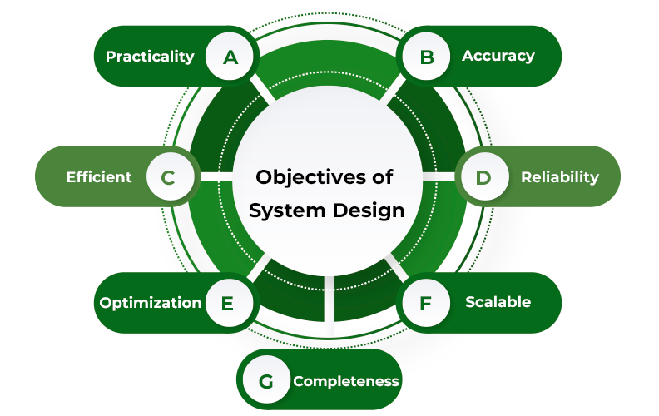
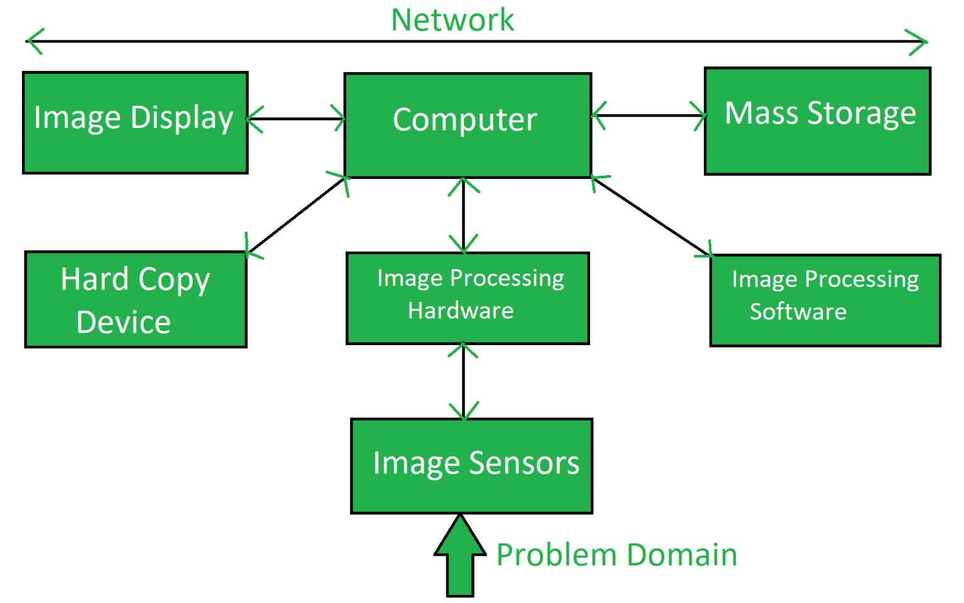
OBJECTIVES
Develop a real-time monitoring system
Integrate cloud storage for live data access
Enhance cargo safety with sensor-based alerts
SYSTEM ARCHITECTURE
Use of ESP32 Kit for IoT connectivity
Sensors (MQ-7, HTS11) for environmental monitoring
Firebase as cloud storage
Web or mobile dashboard for monitoring

Slide 5
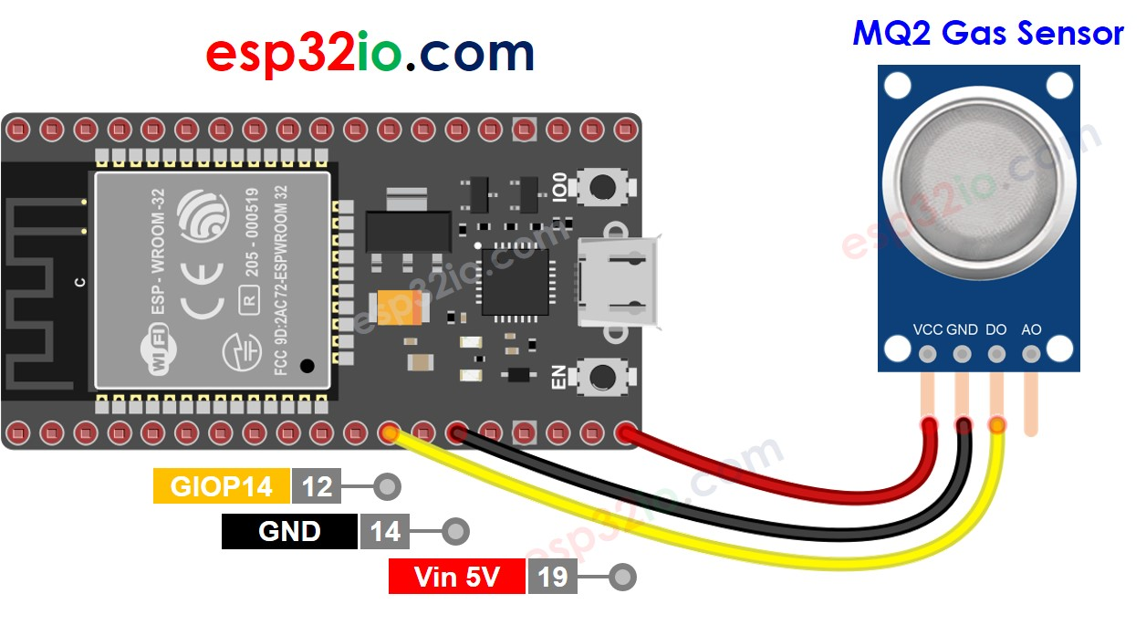

HARDWARE COMPONENTS
ESP32 Kit: IoT controller for data transmission
MQ-7 Sensor: Detects carbon monoxide levels
HTS11 Sensor: Monitors temperature and humidity
SOFTWARE COMPONENTS
Firebase: Cloud database for data storage
Mobile/Web Dashboard: Real-time data visualization
Embedded C/Python: Programming for ESP32

Slide 6
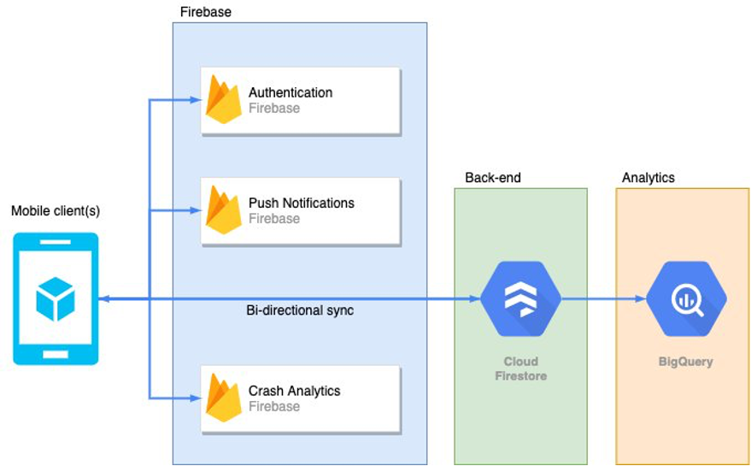
CLOUD INTEGRATION AND DATA FLOW
ESP32 collects sensor data and sends it to Firebase.
Data is stored and retrieved in real time.
Users access data through the app/web dashboard.
Diagram illustrating cloud integration.
REAL TIME MONITORING AND ALERTS
Dashboard displaying live sensor data.
Instant notifications for abnormal readings.

Slide 7
SECURITY AND DATA PRIVACY
Secure authentication for data access.
Data encryption for privacy protection.
IMPLEMENTATION PROCESS
Setting up hardware connections.
Configuring ESP32 with Firebase.
Developing the app/web interface.

Slide 8
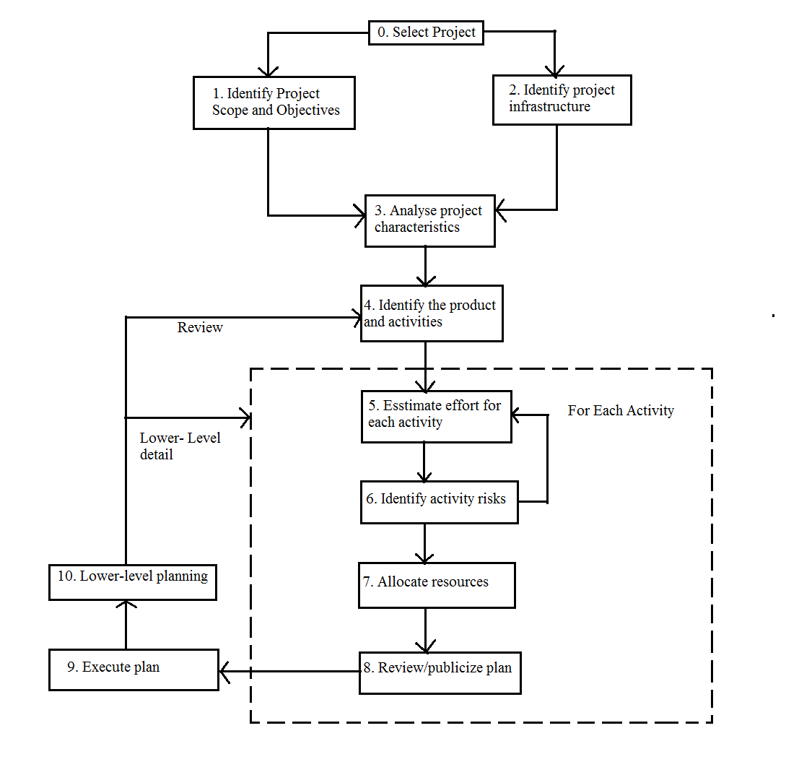
TESTING AND RESULTS
Sensor accuracy testing.
Cloud data synchronization validation.
Performance under different environmental conditions.
CHALLENGES AND SOLUTIONS
Connectivity issues – Optimized network handling.
Power consumption – Implemented low-power modes.

Slide 9
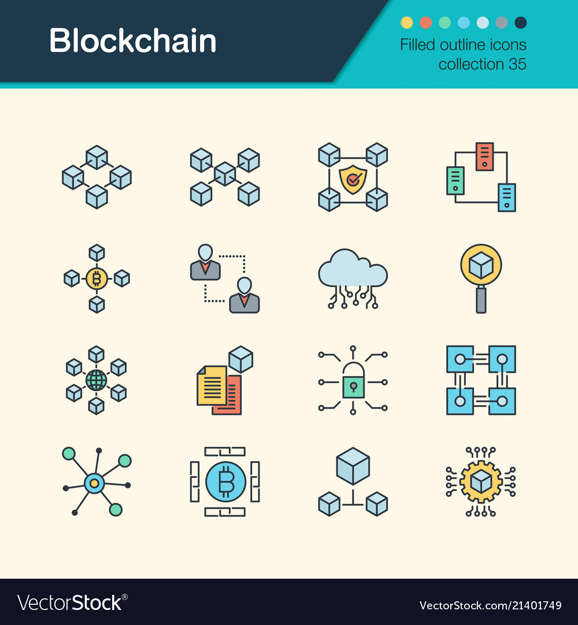
FUTURE ENHANCEMENTS
AI-based predictive analytics for cargo safety.
GPS integration for location tracking.
Expansion to multiple sensor support.

Slide 10
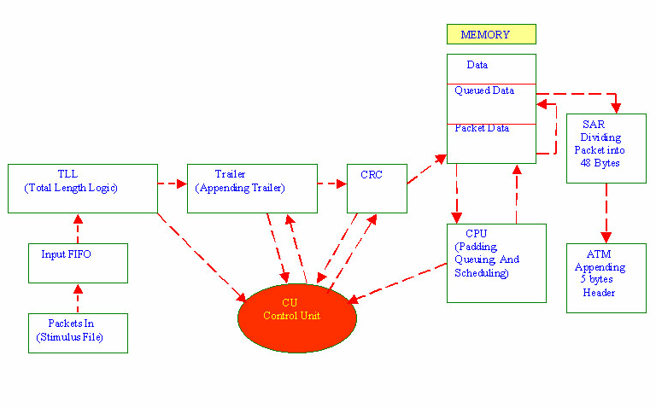
CONCLUSION
Summary of project objectives and outcomes.
Impact of cloud integration on cargo management.
Future scope and real-world applications.

Slide 11
